Slide 1
Code Generation Lecture 16-17

Slide 2
Code Generation
The code generation problem is the task of mapping intermediate code to machine code.
Requirements:
Correctness
Must preserve semantic meaning of source program
Efficiency
Make effective use of available resources
Code Generator itself must run efficiently

Slide 3
Compiler Architecture
Syntactic
structure
Intermediate
Language
Intermediate
Language
tokens
Source
language
Scanner
(lexical
analysis)
Parser
(syntax
analysis)
Semantic
Analysis
(IC generator)
Code
Optimizer
Code
Generator
Target
language
Symbol
Table

Slide 4
Input to the Code Generator
We assume, front end has
Scanned, parsed and translate the source program into a reasonably detailed intermediate representations
Type checking, type conversion and obvious semantic errors have already been detected
Symbol table is able to provide run-time address of the data objects
Intermediate representations may be
Postfix notations
Three address representations
Syntax tree
DAG

Slide 5
Target Programs
The output of the code generator is the target program.
Target architecture: must be well understood
Significantly influences the difficulty of code generation
RISC, CISC
Target program may be
Absolute machine language
It can be placed in a fixed location of memory and immediately executed
Re-locatable machine language
Subprograms to be compiled separately
A set of re-locatable object modules can be linked together and loaded for execution by a linker

Slide 6
Issues in the Design of a Code Generator
Instruction Selection
Register Allocation
Evaluation Order

Slide 7
Instruction Selection
There may be a large number of ‘candidate’ machine instructions for a given IR instruction
Level of IR
High: Each IR translates into many machine instructions
Low: Reflects many low-level details of machine
Nature of the instruction set
Uniformity and completeness
Each has own cost and constraints
Accurate cost information is difficult to obtain
Cost may be influenced by surrounding context

Slide 8
Instruction Selection
For each type of three-address statement, a code skeleton can be designed that outlines the target code to be generated for that construct.
Say, x := y + z
Mov y, R0
Add z, R0
Mov R0, x
Statement by statement code generation often produces poor code

Slide 9
Instruction Selection
a := b + c
d := a + e
MOV b, R0
ADD c, R0
MOV R0, a
MOV a, R0
ADD e, R0
MOV R0, d
MOV R0, a
If a is subsequently used
MOV a, R0

Slide 10
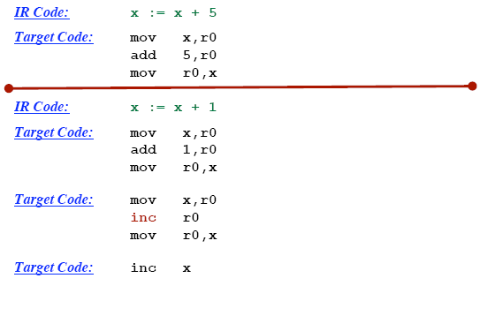
Instruction selection: Machine Idioms

Slide 11
Register Allocation
How to best use the bounded number of registers.
Use or registers
Register allocation
We select a set of variables that will reside in registers at each point in the program
Register assignment
We pick the specific register that a variable will reside in.
Complications:
special purpose registers
operators requiring multiple registers.
Optimal assignment is NP-complete

Slide 12
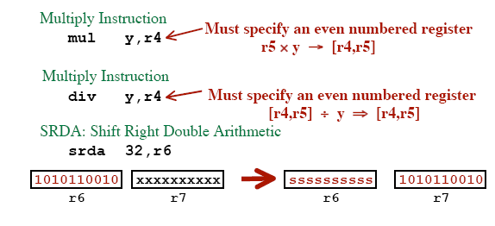
Register Allocation
r4

Slide 13
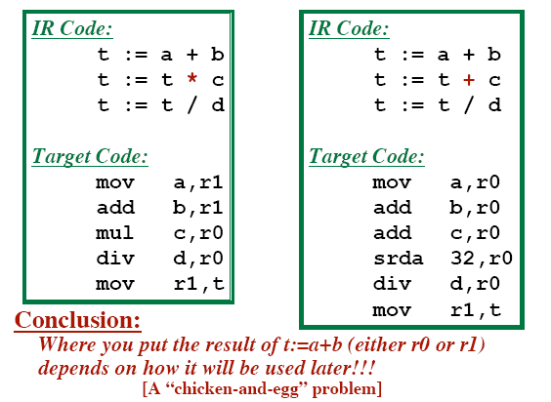
Register Allocation

Slide 14
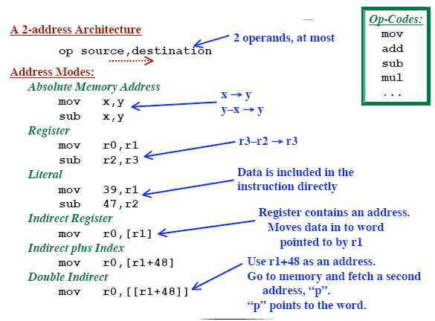
Example Target Machine

Slide 15
Evaluation Order
Choosing the order of instructions to best utilize resources
Picking the optimal order is NP-complete problem
Simplest Approach
Don’t mess with re-ordering.
Target code will perform all operations in the same order as the IR code
Trickier Approach
Consider re-ordering operations
May produce better code
... Get operands into registers just before they are needed
... May use registers more efficiently

Slide 16
Moving Results Back to Memory
When to move results from registers back into memory?
After an operation, the result will be in a register.
Immediately
Move data back to memory just after it is computed.
May make more registers available for use elsewhere.
Wait as long as possible before moving it back
Only move data back to memory “at the end”
or “when absolutely necessary”
May be able to avoid re-loading it later!

Slide 17
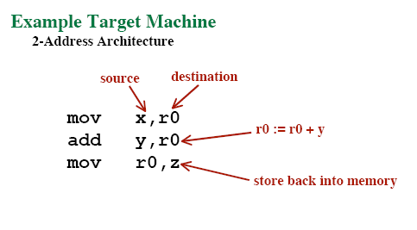
Code Generation Algorithm #1
Simple code generation algorithm:
Define a target code sequence to each intermediate code statement type.

Slide 18
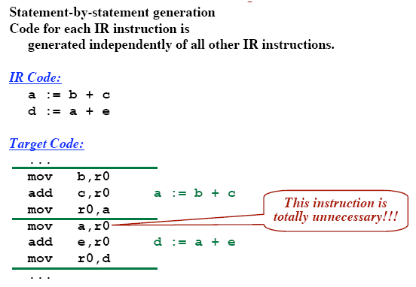
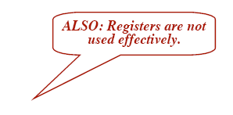
Code Generation Algorithm #1

Slide 19
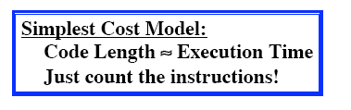
Evaluating A Potential Code Sequence
Each instruction has a “cost”
Cost = Execution Time
Execution Time is difficult to predict.
Pipelining, Branches, Delay Slots, etc.
Goal: Approximate the real cost
A “Cost Model”

Slide 20
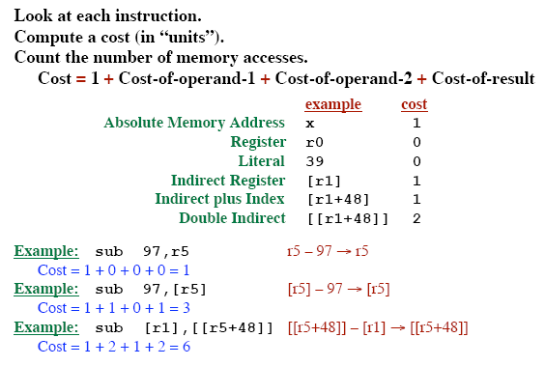
A Better Cost Model

Slide 21
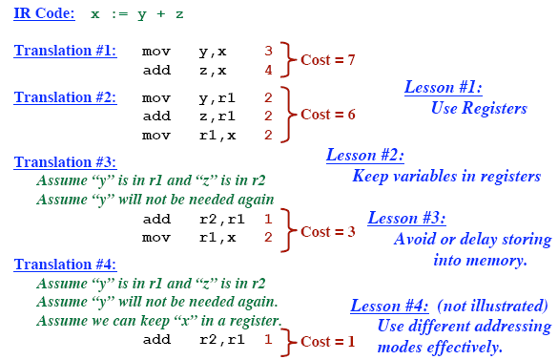
Cost Generation Example

Slide 22
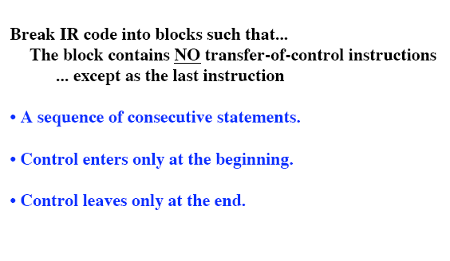
Basic Blocks

Slide 23
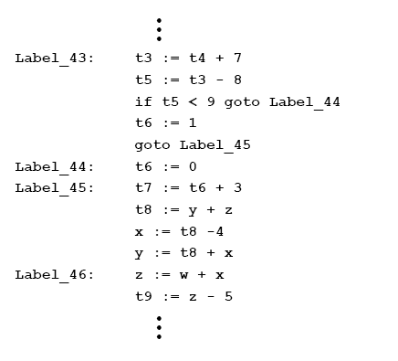
Basic Blocks

Slide 24
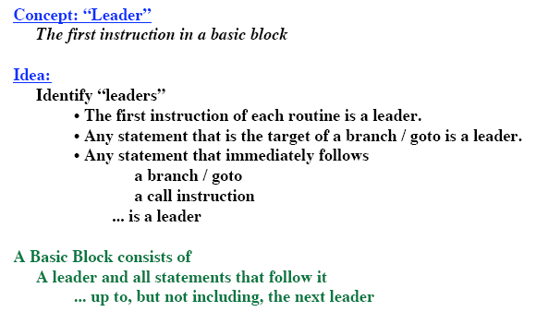
Algorithm to Partition Instructions into Basic Blocks

Slide 25
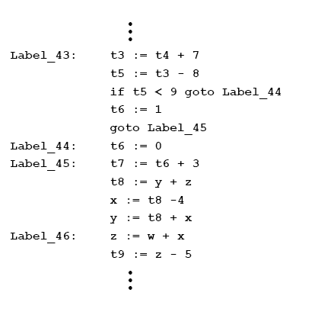
Identify Leaders – Example 1:

Slide 26
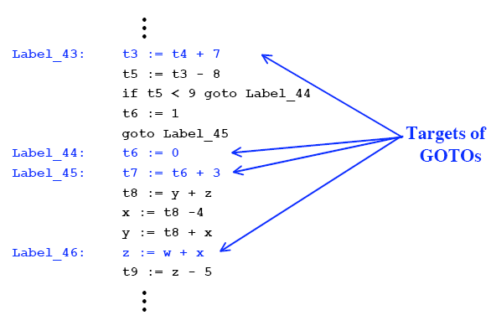
Identify Leaders – Example 1:

Slide 27
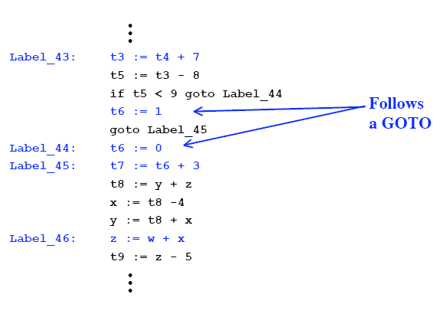
Identify Leaders – Example 1:

Slide 28
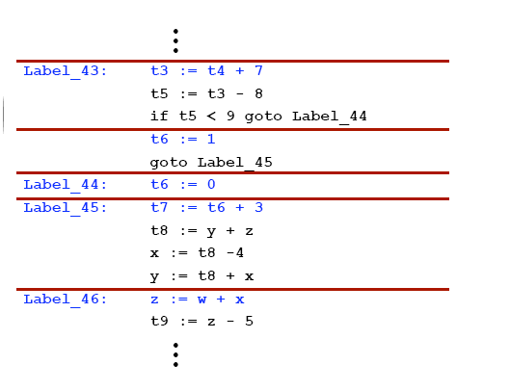
Identify Leaders

Slide 29
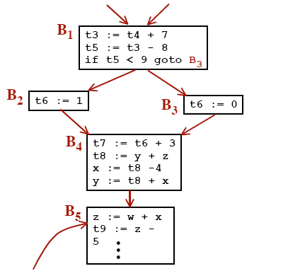
Control Flow Graph

Slide 30
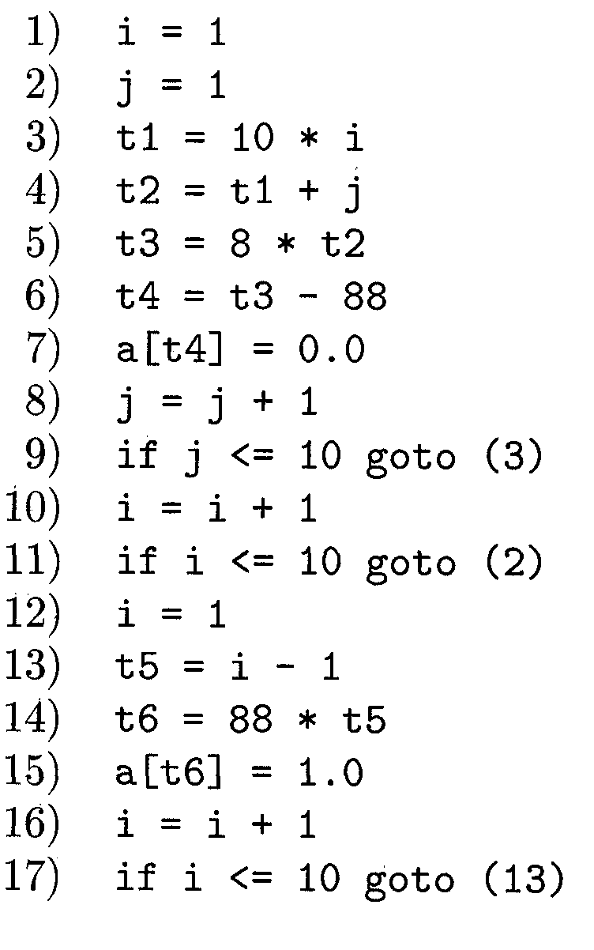
Identify Leaders – Example 2:

Slide 31
Identify Leaders – Example 2:
According to rule 1 : 1
According to rule 2 : 3, 2, 13
According to rule 3 : 10, 12

Slide 32
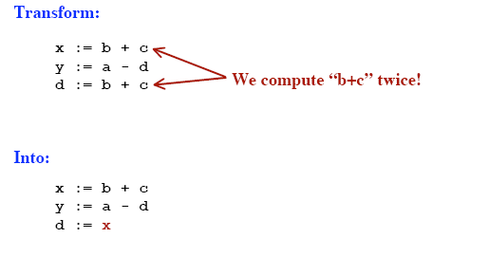
Common Sub-Expression Elimination

Slide 33
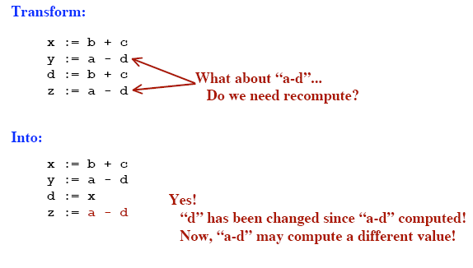
Common Sub-Expression Elimination

Slide 34
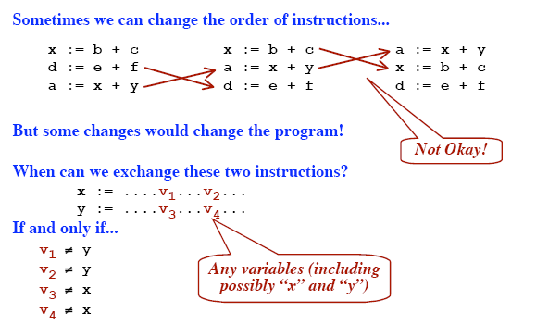
Reordering Instructions in a Basic Block

Slide 35
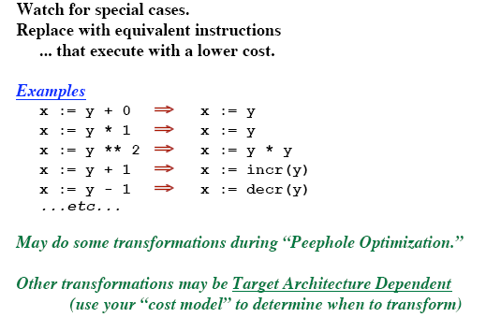
Algebraic Transformation

Slide 36
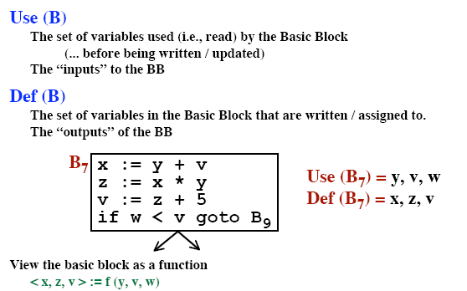
Look at Each Basic Block in Isolation

Slide 37
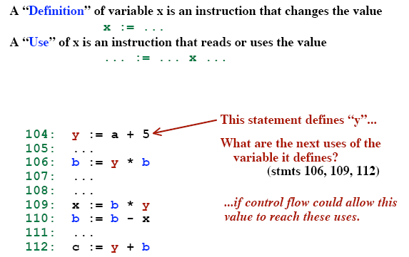
Definition and Use of variables

Slide 38
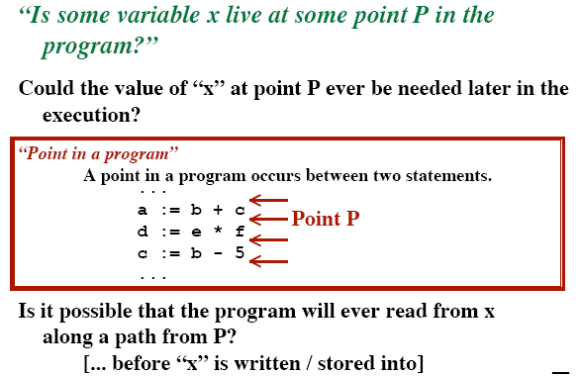
Live Variables

Slide 39
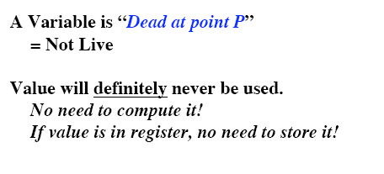
Dead Variables

Slide 40
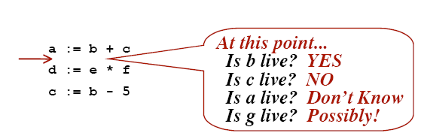
Liveness Example

Slide 41
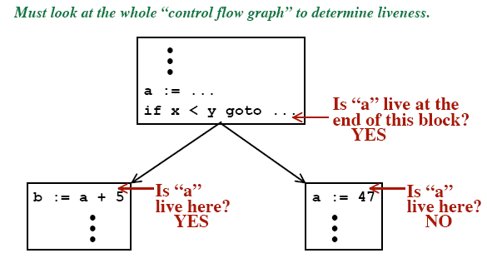
Liveness Example

Slide 42
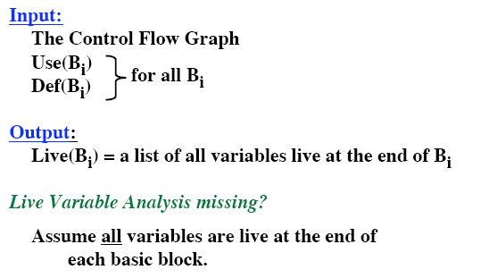
Live Variable Analysis

Slide 43
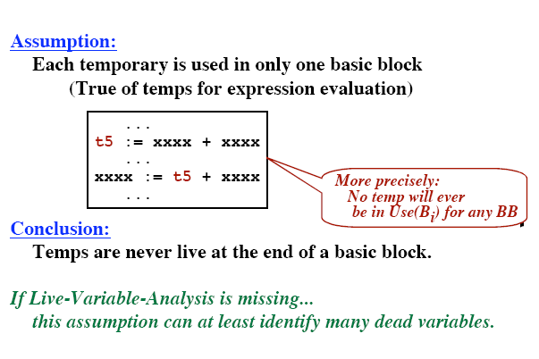
Temporaries

Slide 44
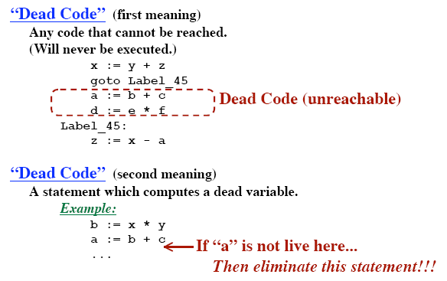
Dead Code

Slide 45
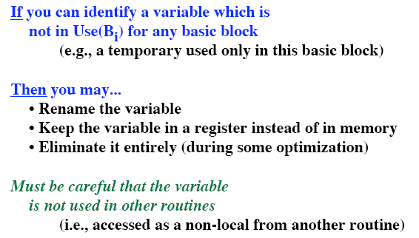
Temporaries

Slide 46
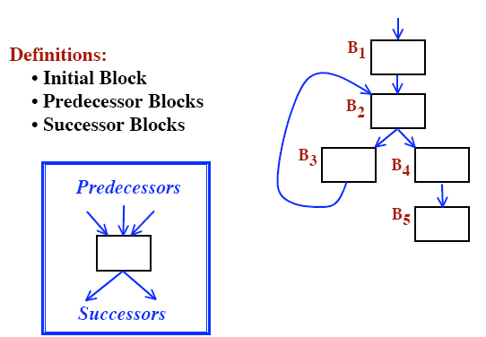
Control Flow Graphs

Slide 47
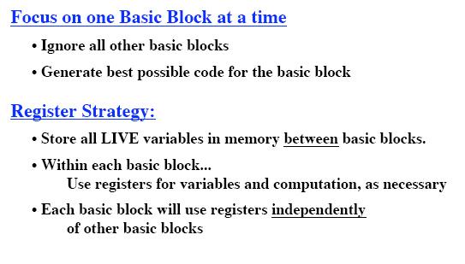
Code Generation Algorithm #2

Slide 48
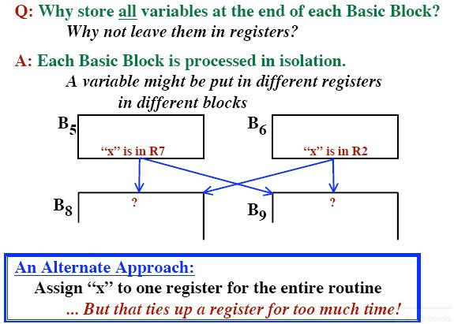
Code Generation Algorithm #2

Slide 49
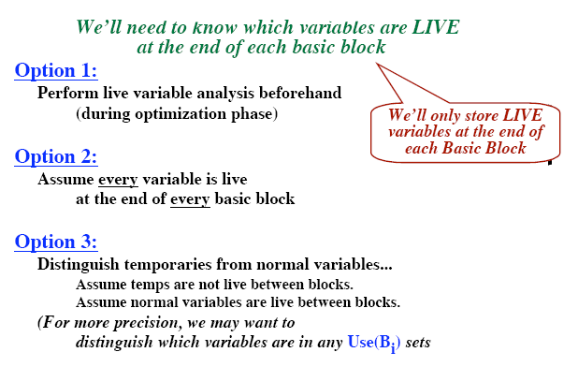
Code Generation Algorithm #2

Slide 50
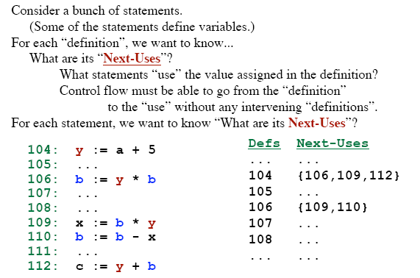
The “Next-Use” Information

Slide 51
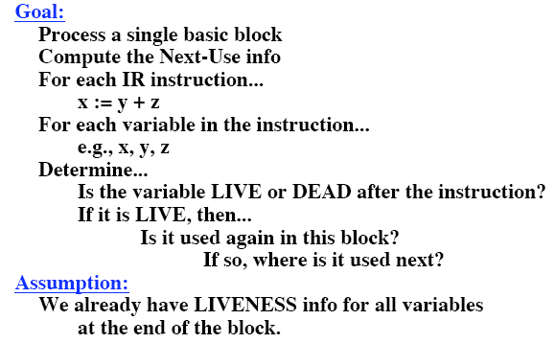
The “Next-Use” Algorithm

Slide 52
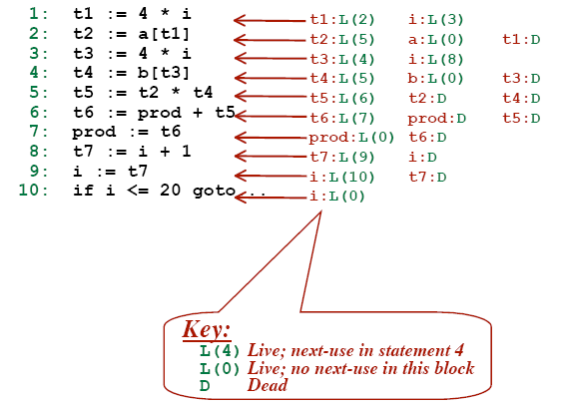
“Next-Use” Example

Slide 53
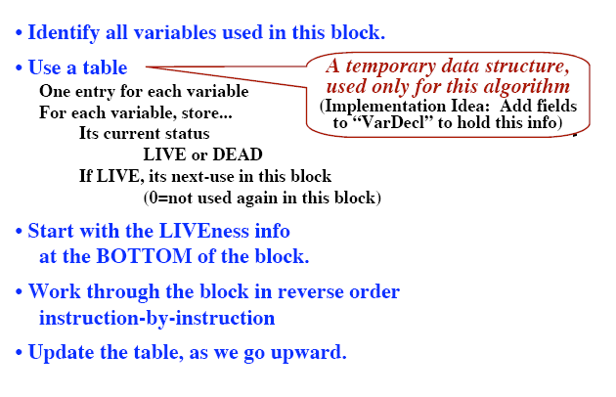
“Next-Use” Algorithm

Slide 54
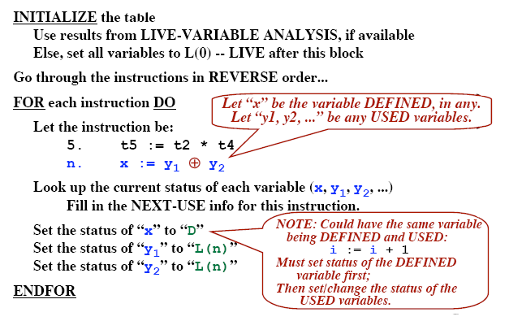
“Next-Use” Algorithm

Slide 55
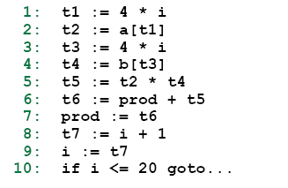
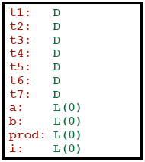
“Next-Use” Algorithm - Example

Slide 56
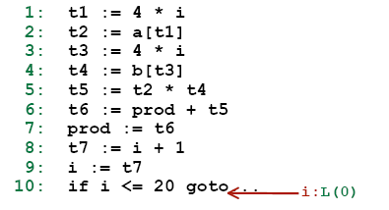
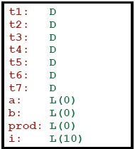
“Next-Use” Algorithm - Example

Slide 57
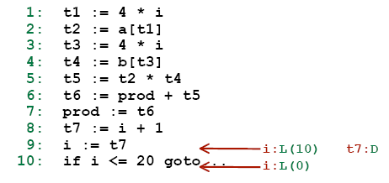
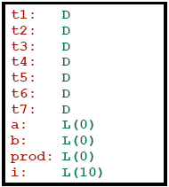
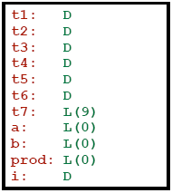
“Next-Use” Algorithm - Example

Slide 58
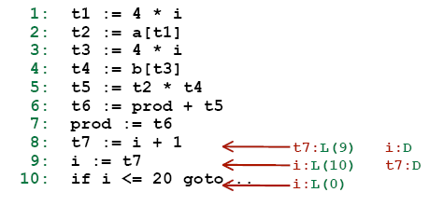

“Next-Use” Algorithm - Example

Slide 59


“Next-Use” Algorithm - Example

Slide 60


“Next-Use” Algorithm - Example

Slide 61


“Next-Use” Algorithm - Example

Slide 62


“Next-Use” Algorithm - Example

Slide 63


“Next-Use” Algorithm - Example

Slide 64


“Next-Use” Algorithm - Example

Slide 65



“Next-Use” Algorithm - Example
D
L ( 1 )

Slide 66

Why Live Variable analysis?

Slide 67

Code Generation Algorithm #2

Slide 68

Code Generation Algorithm #2

Slide 69

Data Needed during Code Generation

Slide 70

Example

Slide 71

Example

Slide 72

Example

Slide 73

Example

Slide 74

Example

Slide 75

Example

Slide 76

Example

Slide 77

Example

Slide 78

Example

Slide 79

Example

Slide 80

Example

Slide 81

Example

Slide 82

Example

Slide 83

Example

Slide 84
Any Question ?

